Slide 1

Go Norquest
CMPT 3830
Md Mahbub Mishu
Notes:
Nav

Slide 2
Group Members
Dionathan Dos Santos ~ Model Developer
Mayank Khera ~ Data gathering and preparation (Scrum Master)
Navkirat Singh ~ Team Leader
Vinit Kataria ~ Result Interpreter and presenter
Notes:
Nav

Slide 3
Problem Statement
Identify what geographical regions in Edmonton are the best sellers.
Cluster regions by number of sales and total gross sale.
Consider creating a model for used cars and another one for new cars.
For visualization, generate necessary graphs, charts etc. in your dashboard.
Notes:
Nav

Slide 4
Dataset Overview
Source(s) of Data:
Data provided by Go Auto's Business Intelligence Team.
Includes vehicle listings from Canadian Black Book (CBB) API for Edmonton dealerships.
Number of Records and Features:
Total records: 145,114 (rows).
Number of features (variables): 15, including price, mileage, model year, stock type, and dealer location.
Key Features:
Price: Vehicle selling price (numerical).
Mileage: Total mileage of the vehicle (numerical).
Model Year: Year the vehicle was manufactured (numerical).
Stock Type: Categorized as either new or used (categorical).
Dealer Postal Code: Location identifier for each dealer (categorical).
Handling of Missing Values:
No significant missing values detected in key features.
Minor data cleaning steps performed for standardization of postal codes and model names.
Notes:
Dionathan

Slide 5
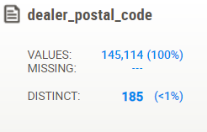
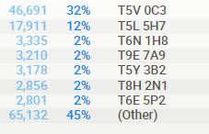
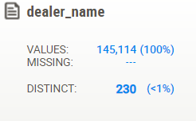
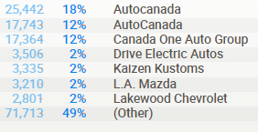
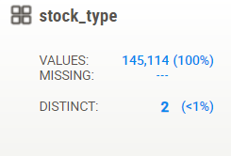
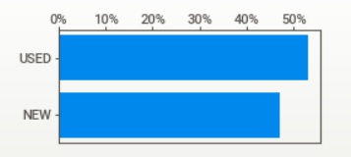
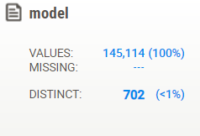
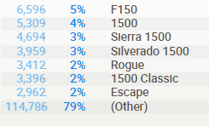
Statistical Data
*Made with Sweetviz library in Python
Dealer Distribution: Most vehicles are concentrated in postal codes like T5V 0C3 and T5L 5H7, with AutoCanada as the top dealership by volume.
Stock Type Breakdown: About 50% of the vehicles are used, with a slight edge over new vehicles in the stock listings.
Notes:
Vinit

Slide 6
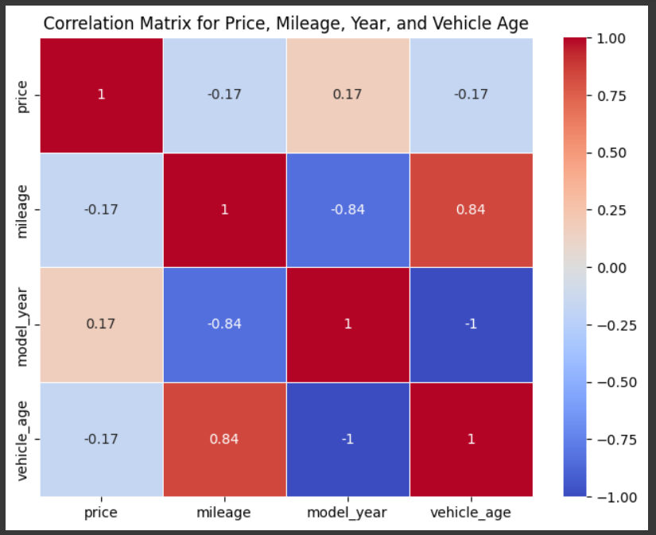
Correlation Analysis
Key Correlation Insights: Strong negative correlation between mileage and model year (-0.84) indicates that newer cars tend to have lower mileage.
Price Relationships: Price shows weak correlations with other variables, meaning that price is not strongly driven by mileage, year, or vehicle age alone.
Notes:
Mayank

Slide 7
#10 Dealers (Total Amount Sold/ $)
Dealership | #Cars Sold | $ Total Sold
Autocanada | 809 | $ 10,277,477.00
Canada One Auto Group | 533 | $ 7,126,429.00
House Of Cars Leduc | 291 | $ 5,022,718.00
House Of Cars Argyll | 175 | $ 3,028,800.00
Northgate Chevrolet Buick Gmc | 92 | $ 1,717,942.00
Xs Credit | 85 | $ 741,715.00
The Truck Depot (A Division Of L.A. Nissan) | 84 | $ 767,533.00
AutoCanada | 84 | $ 919,811.00
Kaizen Kustoms | 79 | $ 1,160,062.00
Sherwood Park Chevrolet | 79 | $ 1,786,673.00
Notes:
Dionathan

Slide 8
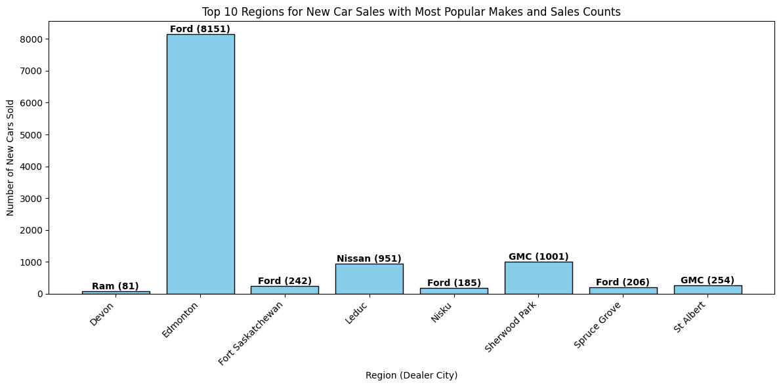
Top 10 Regions for New cars sales by Most Popular Makes
*Edmonton leads in Ford sales, significantly outpacing other regions, indicating a concentrated demand in this area.
Notes:
Vinit

Slide 9
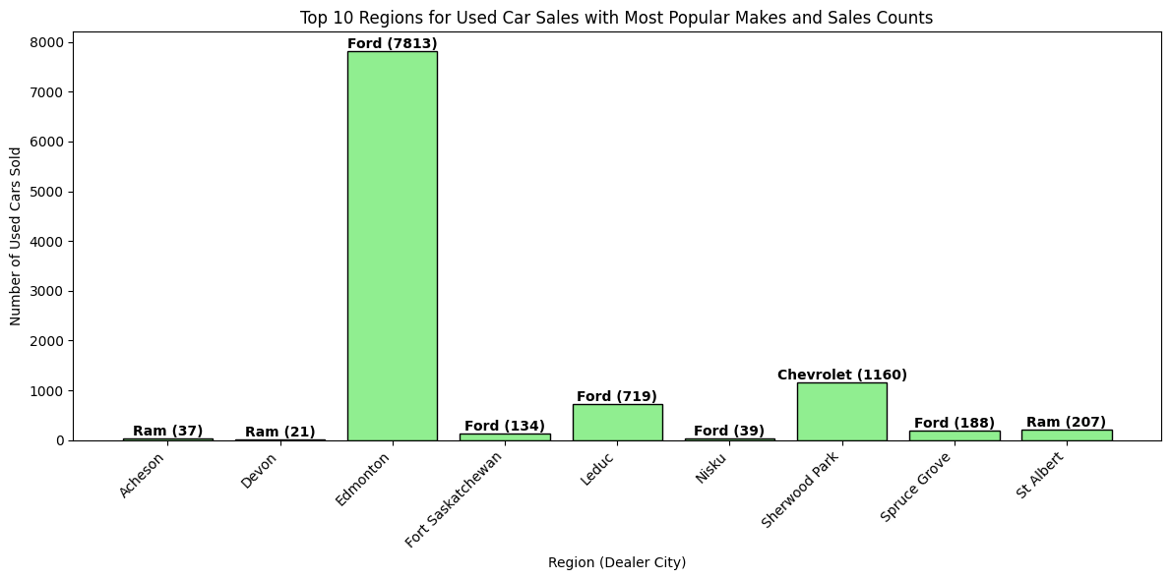
Top 10 Regions for Used cars sales by Most Popular Makes
*Edmonton significantly leads in used Ford sales, showing a clear preference for Ford vehicles in the used car market.
Notes:
Vinit

Slide 10
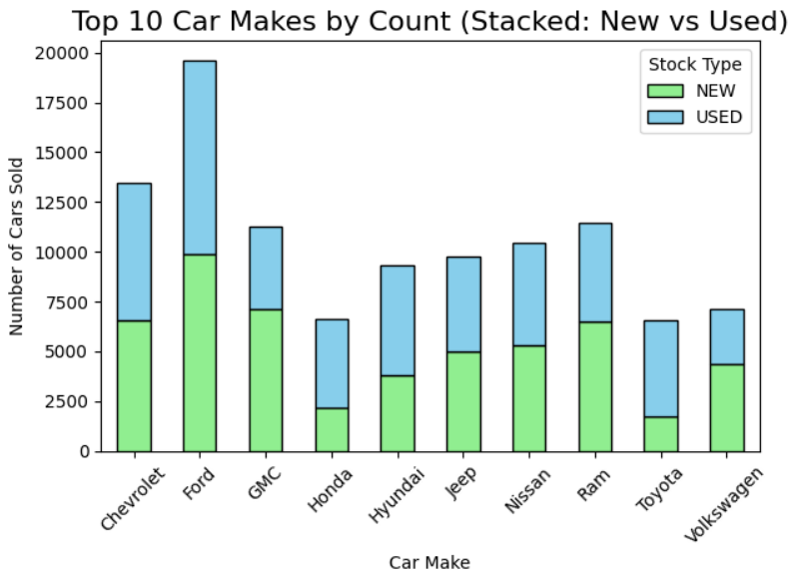
Top 10 Sold Cars by Most Popular Makes and Car Stock Type
*Ford leads in both new and used car sales, with used vehicles making up a larger portion of total sales across most brands.
Notes:
Mayank

Slide 11
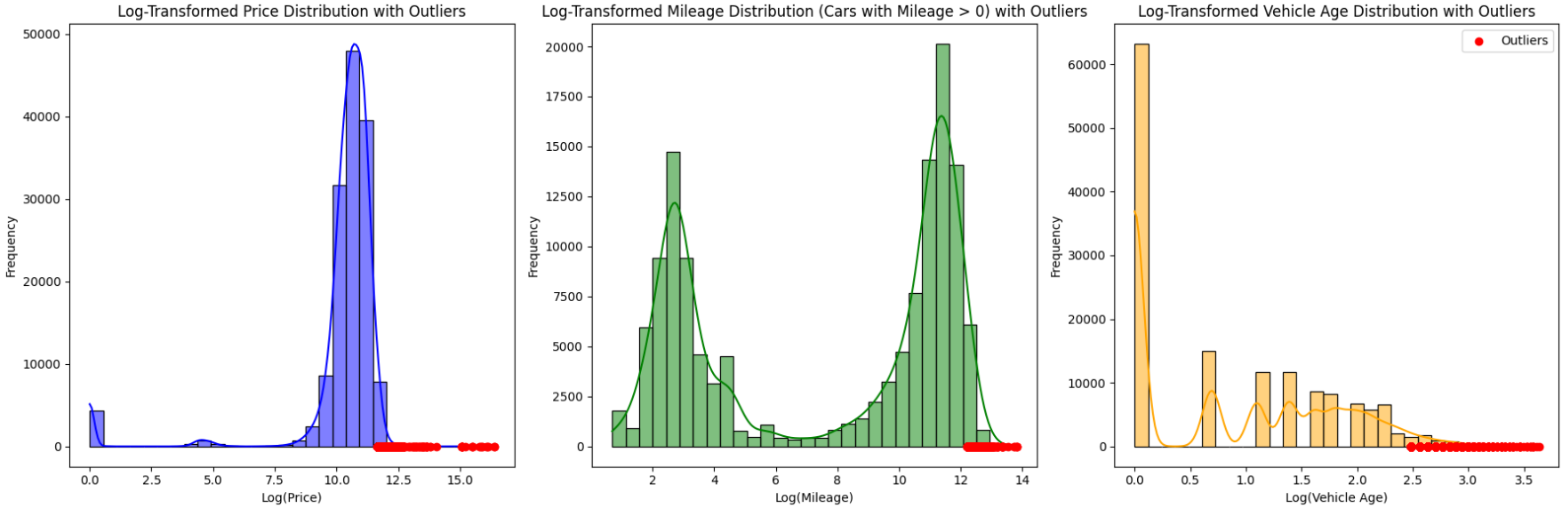
Log-Transformed Distributions of Price, Mileage, and Vehicle Age with Outliers
Log Transformation & Outliers: Each plot shows a log-transformed distribution to normalize skewed data for price, mileage, and vehicle age. Noticeable outliers (in red) suggest potential anomalies that may need further investigation or handling in model development.
Notes:
Dionathan

Slide 12
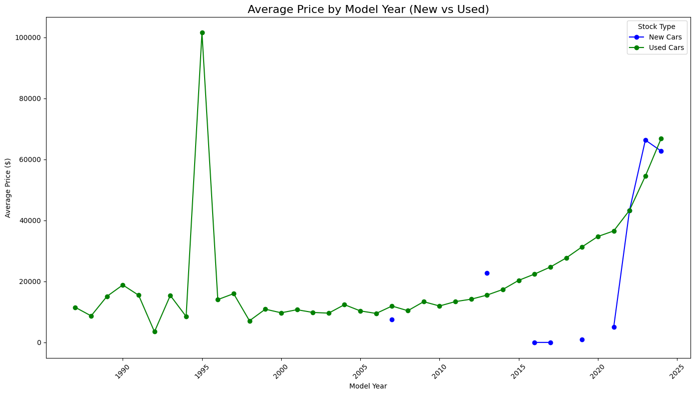
Average Price VS Model year
Notes:
Vinit

Slide 13
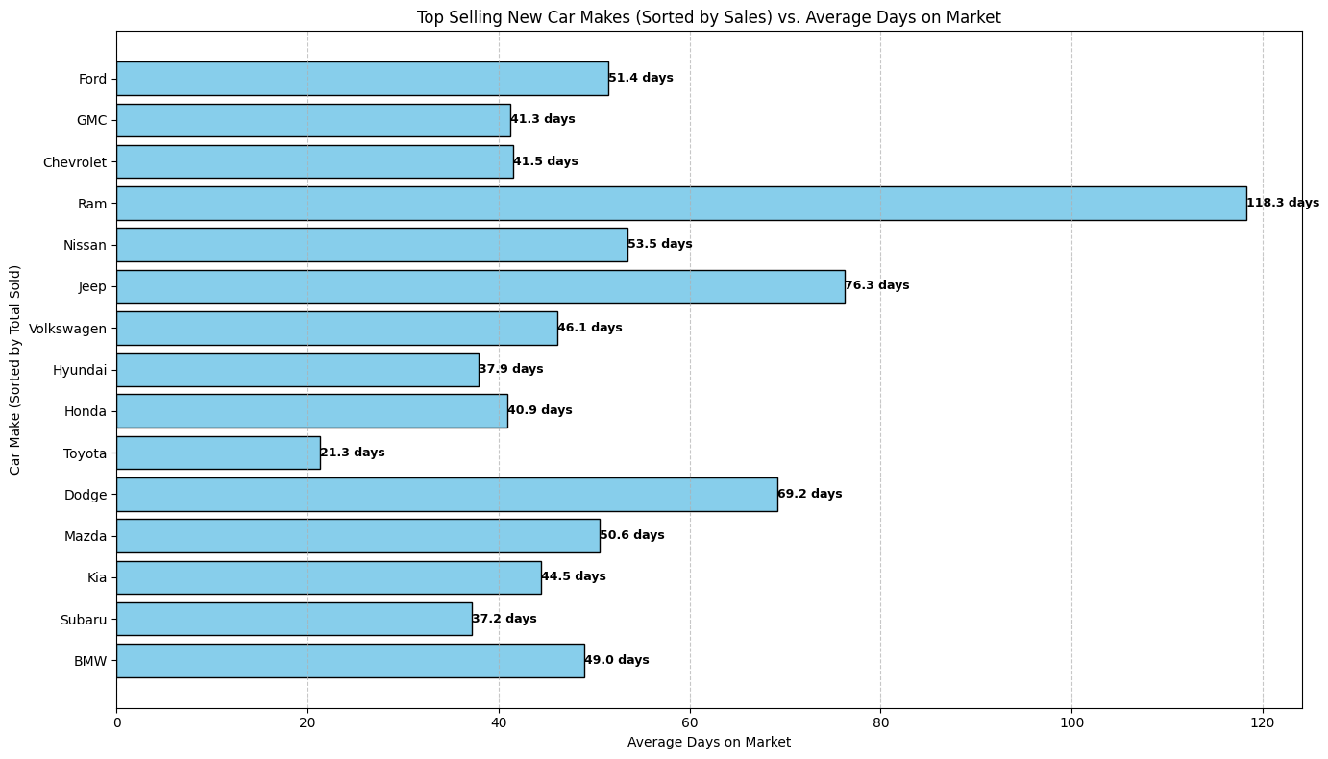
Top Selling cars VS average days on the market - New cars
Notes:
Mayank

Slide 14
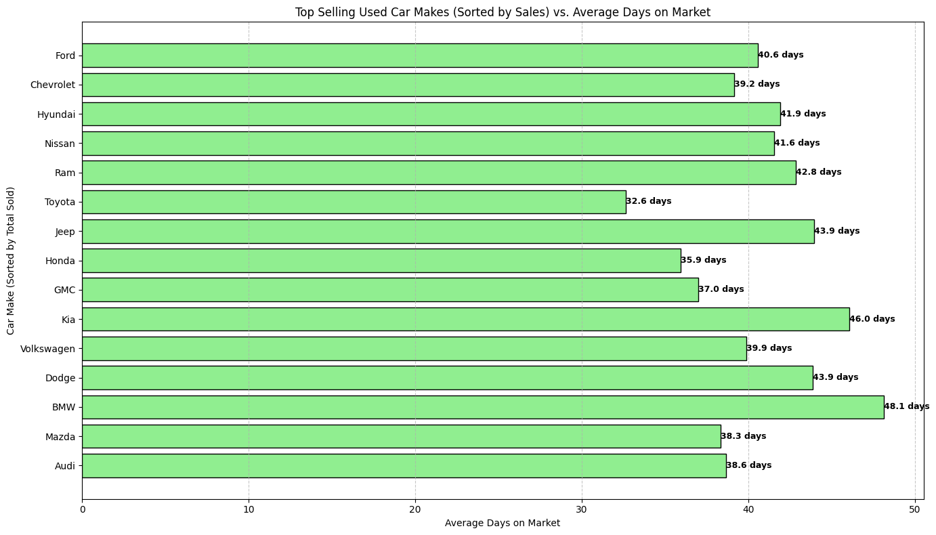
Top Selling cars VS average days on the market - Used Cars
Notes:
Mayank

Slide 15
Next Steps
Model Refinement: Further fine-tune the clustering and regression models by addressing identified outliers and improving feature selection.
Segmentation by Stock Type: Develop separate models and visualizations for new and used car sales to capture distinct market behaviors.
Geographical Targeting: Use the insights from best-selling regions to guide marketing strategies and optimize inventory allocation.
Validation and Testing: Perform cross-validation and test the models with new data to ensure generalizability and accuracy.
Dashboard Finalization: Refine the visualizations in PowerBI for clearer insights.
Notes:
Nav

Slide 16
Thank You!
Notes:
Dionathan

